Slide 1

Internet Computer Protocol:
Overview of the IC Ecosystem and Core Differences

Slide 2




Content
1
Brief history and background of the Internet Computer Protocol
2
Purpose and vision of the IC Protocol
3
Key components in the IC ecosystem
4
Conclusion

Slide 3



What is ICP?
The Internet Computer Protocol, developed by the DFINITY Foundation.
Revolutionary blockchain infrastructure that seeks to expand the functionality of public internet.
Officially launched in 2021 after several years of intense development.

Slide 4
Purpose and Vision of the IC Protocol
The primary vision of IC is to provide a limitless environment
Directly on the public internet without needing central infrastructure or services
Notes:
*1
The Internet Computer (IC) is not just another blockchain platform. It is a radical new way of building and running software on the internet. Imagine if you could create any kind of application or service without worrying about servers, hosting, scalability, security, or performance. Imagine if you could deploy your code directly to the public internet and let it run forever. Imagine if you could access any data or functionality on the web with a single click. That is the primary vision of IC: to provide a limitless environment for developers and users to create and enjoy the next generation of internet services.
*2
second text:
One of the most amazing features of the Internet Computer is that it allows you to run your software directly on the public internet without needing any central infrastructure or services. This means you don’t have to rely on third-party providers like Amazon, Google, or Facebook to host your applications or store your data. You don’t have to worry about censorship, downtime, hacking, or fees. You don’t have to compromise on your privacy, security, or sovereignty. You can simply write your code and deploy it to the Internet Computer network, which is composed of thousands of independent nodes that work together to provide a seamless and unstoppable computing environment.

Slide 5
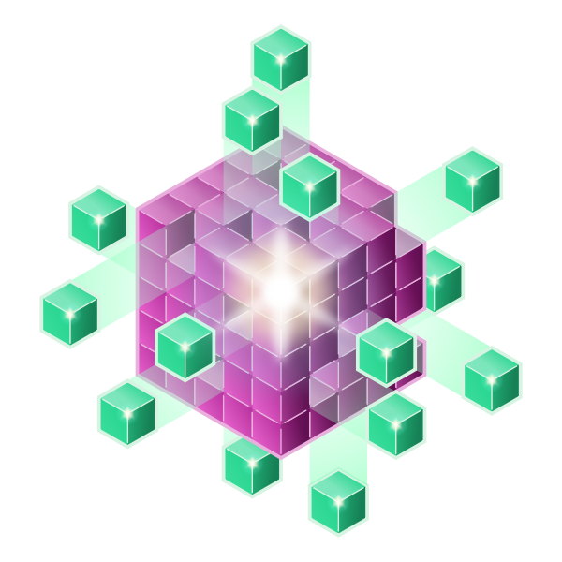
Key Components of IC Ecosystem
Canisters
Data Centers
Chain Key Technology
Nodes and Subnets
Network Nervous System
Notes:
Data centers: Data centers are physical locations that host the hardware and software components of the Internet Computer network. They are composed of servers, storage devices, routers, switches, and other equipment that provide computing power, storage capacity, and network connectivity. Data centers are distributed across the world and operated by independent providers who contribute their resources to the network in exchange for rewards.
Nodes and Subnets: Nodes are individual computers that run the Internet Computer Protocol (ICP) and execute the software deployed on the network. Nodes are grouped into subnets, which are collections of nodes that work together to provide a specific service or functionality. Subnets can communicate with each other through message passing and can scale up or down depending on the demand. Subnets are also responsible for ensuring the security and reliability of the network by validating transactions and reaching consensus.
Network Nervous System: The Network Nervous System (NNS) is a decentralized governance system that controls and manages the Internet Computer network. The NNS is composed of neurons, which are smart contracts that represent the voting power of network participants. Neurons can propose, vote on, and execute proposals that affect various aspects of the network, such as upgrading the protocol, creating new subnets, allocating resources, setting fees, and more. The NNS is designed to be adaptive, responsive, and transparent, allowing the network to evolve and improve over time.
Chain Key Technology:The correct operation of subnets (and inter-subnet communication) relies on a suite of novel cryptographic protocols, collectively referred to as chain-key cryptography. Chain-key cryptography makes it possible for subnets to authenticate
responses to user requests,
the subnet state, and
inter-subnet messages in a completely decentralized way.
Canisters: Canisters are the basic unit of software deployment and execution on the Internet Computer network. Canisters are self-contained bundles of code, data, and memory that run on subnets and communicate with each other through messages. Canisters can implement any kind of functionality, such as web services, smart contracts, decentralized applications, or user interfaces. Canisters are scalable, secure, and autonomous, meaning they can adjust their resource consumption, protect themselves from malicious attacks, and manage their own lifecycles.
These components work together to create a seamless and unstoppable computing environment that can host any kind of software or service on the public internet. The Internet Computer network aims to provide a limitless platform for developers and users to create and enjoy the next generation of internet services.

Slide 6
Conclusion
The Internet Computer, an innovative blockchain network launched by the DFINITY Foundation in May 2021, aspires to be a scalable, open, and secure World Computer.
It hosts programs and data as smart contracts, known as canisters, on a network of subnets, with each canister having its own isolated data storage and communicating seamlessly with others across the network.
The Internet Computer Protocol (ICP), at the core of the network, ensures fault tolerance and scalability.

